Slide 1


Empowering Smart Hiring Decisions
A browser extension and platform integrated with job sites.
Group 3 – Next 72

Slide 2

Recruitment Challenges
1
Lack of verified information
Current platforms lack real-time information on companies and employees.
2
Unreliable feedback
Feedback during the hiring process is often incomplete or unreliable.
3
Difficult assessment
Employees struggle to evaluate company culture.

Slide 3
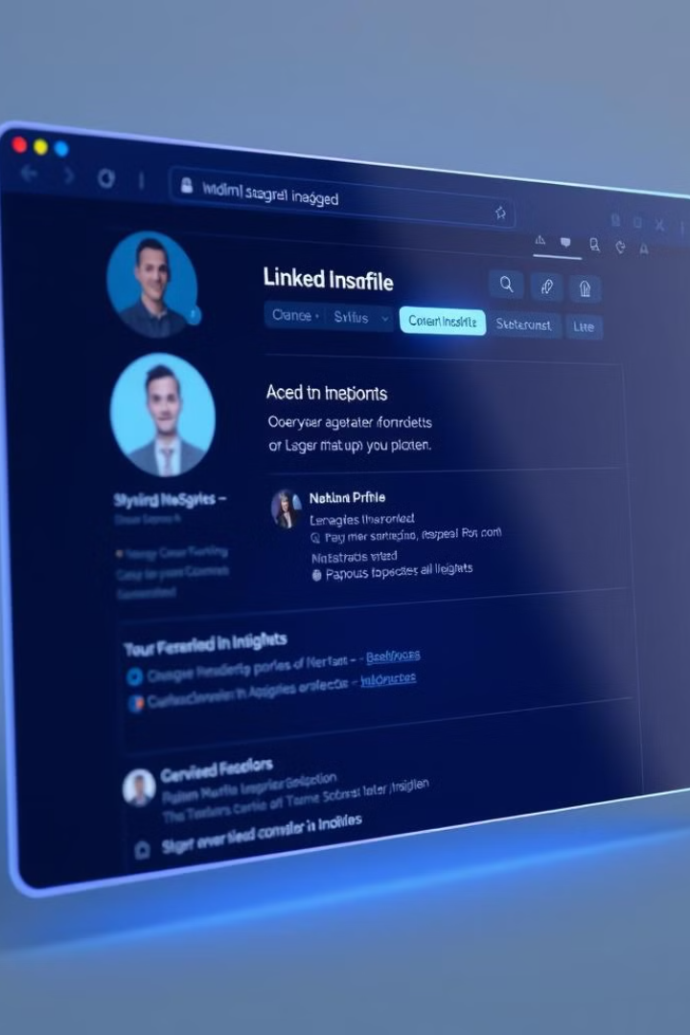
Our Innovative Solution
1
Browser Extension
Integrates with job platforms like LinkedIn and Indeed.
2
Verified Insights
Provides real-time information on companies and employees.
3
Informed Decisions
Helps users make smarter hiring decisions.

Slide 4
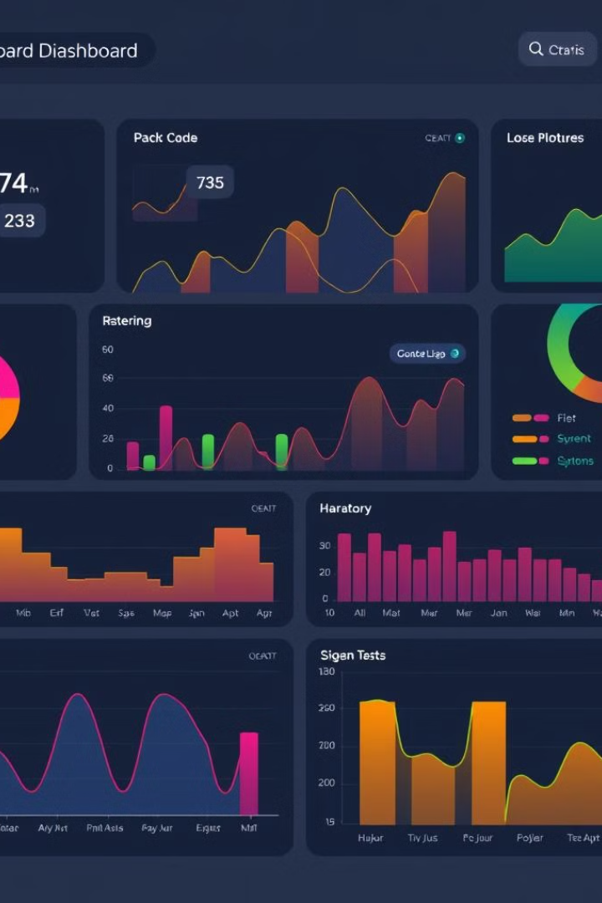



Key Features
Verified Reviews
Reliable and authentic data on companies and employees.
Browser Extension
Display reviews directly on job profiles.
Real-time Analytics
Dashboards with up-to-date information.

Slide 5





How it works
Installation
Install the extension for LinkedIn and Indeed.
Access to reviews
Check verified reviews on company and employee profiles.
Trend analysis
Use the dashboard to analyse trends.
Informed decision
Make hiring decisions based on reliable data.

Slide 6
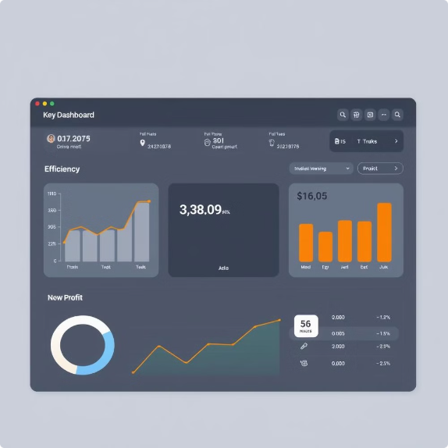




Why choose us?
Increased Decision Accuracy
User-Friendly Integration
Innovative Business Model
Cost-Effective Insights
Scalable for All Business Sizes

Slide 7

Target Audience
Employers
Get better insights to improve hiring accuracy.
Job Seekers
Make informed decisions about potential employers.
Recruiters
Match candidates to the right companies using verified feedback.
HR Teams
Use feedback to improve retention and company culture.

Slide 8








Business Model
(Revenue streams)
1
2
3
4
Freemium Model:
Free basic features with paid access to premium insights and analytics.
(For natural spreading)
Company Subscriptions:
Charge companies for access to verified reviews and analytics.
Sponsored Individuals and Company Profiles
Data Licensing:
Sell anonymized data to HR firms and recruitment agencies.

Slide 9




Join Us
Focus on Opportunity
Be Part of the Future of Smart Hiring
Visit Our Website
For more details on our services.
Contact Us
For any questions or information requests.

Slide 10

Thank You
We appreciate your time and interest in our innovative hiring solution.

